Slide 1
Learn, Build, Deploy, and Dismantle
C2/Botnets
Help you to identify, analyze and resolve these threats in the wild
Presenter: Maks Derevencha
Content (Short URL): www.tinyurl.com/maks-botnet
Full URL github.com/maxacode/Learn-Build-Deploy-and-Dismantle-Botnets
Notes:
http://hilite.me/

Slide 2

Maks Derevencha
Live in Florida, 2 Kids, Fishing, Flying Airplanes, 3D Printing
Prior Companies: AWS, Goldman Sachs, Citi Group, Epic/Riot Games, Domestic/International Governments & Militaries
Roles: CISO, Incident Response, Malware, Forensics, etc
14 years in Cyber Security
Cyber Security Adjunct Professor at various Universities

Slide 3
Please do the following before we start:
Wifi: Password:
Labs: www.tinyurl.com/maks-botnet
Download/Instal Python: www.Python.org
Download/Install VSCode: code.visualstudio.com
if you can’t install use online ide: https://vscode.dev
Test python in VSCode:
print(“hello world”)

Slide 4
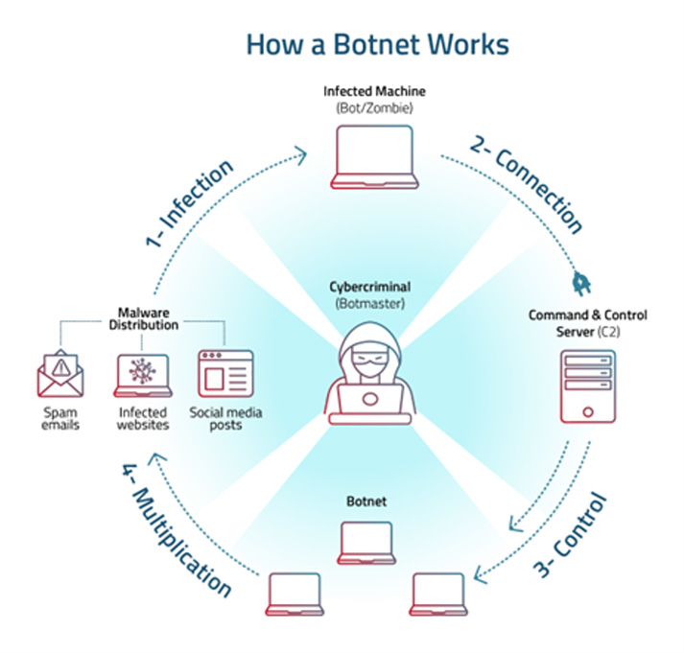
C2 and Botnets
C2, C&C, Command and Control:
A Platform that enables commanders to issue instructions, receive data, and maintain situational awareness over endpoints.
A botnet:
A group of devices that can be controlled to do the bidding of the Botnet owner.

Slide 5
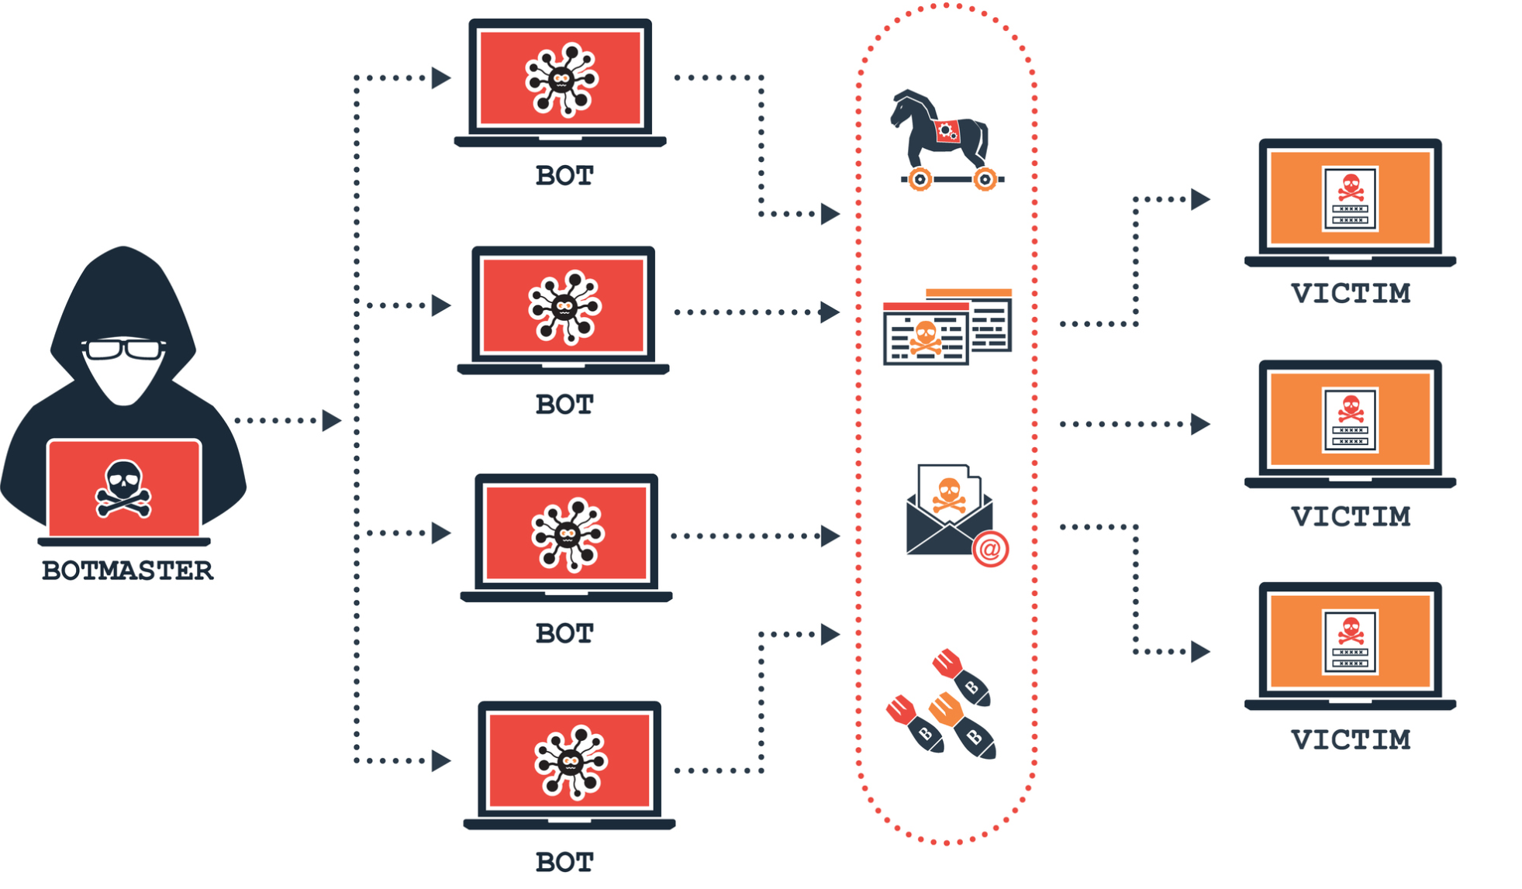
Why Learn C2/Botnet
We can better identify and analyze these threats when we encounter them in the wild.
Understanding how these systems are built and operated allows for more effective threat intelligence gathering and incident response.
Helps us to anticipate and simulate potential attacks. Develop and implement robust defense mechanisms, enhancing the overall security posture of their organization.
Disrupt and Restore: We can leverage this knowledge to disrupt malicious operations, minimize damage, and restore normalcy to affected systems.
Ethical Hacking and Penetration Testing: It enables us to simulate realistic attack scenarios, uncover vulnerabilities, and provide actionable recommendations to strengthen security defenses.

Slide 6

Python Review

Slide 7
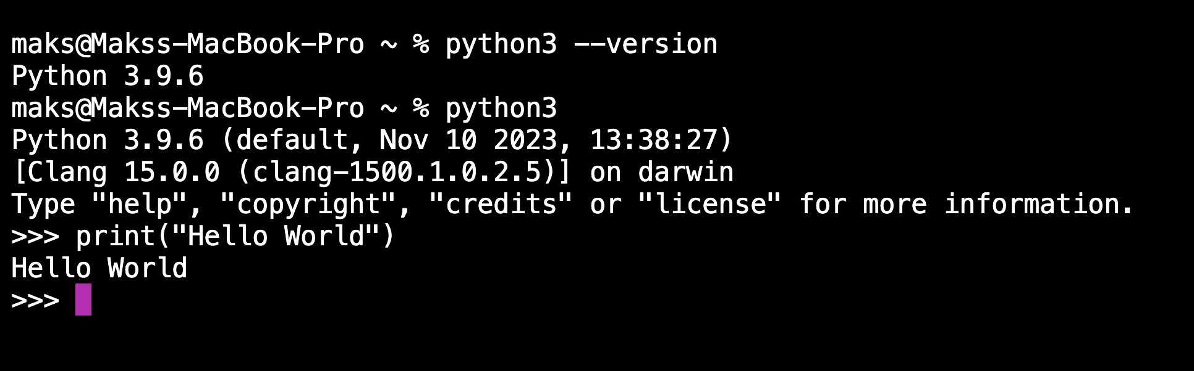
Python Review
Test with these commands in CMD/Terminal:
python3 –version
python –version
py –version

Slide 8
Comments
Hashtag (#) renders an entire line as a comment.
Three quotation marks (""") are used in the beginning and end of multi-line comments.
Three quotation marks can be used in print() to print multi-line strings.
#This is a comment
print("Hello World!")
"""
This is how a multi-line string
Comment looks.
"""

Slide 9
Python Variables
Python will automatically detect the data type.
The syntax varies depending on the data type.
A variable name must begin with a letter or underscore.
myString = "this is a string"
print(myString)
> this is a string
myNum = 48
print (myNum)
>> 48
myBool = True
print (myBool)
>> True
myfloat = 1.75
print(myfloat)
>> 1.75

Slide 10
Print / f String
The input function is used to ask users for input.
Input variables will always be a string data type unless they are converted.
Print with Variables
name = input("Please enter your name: \n")
age = input("Please enter your age: \n")
height = input("Please enter your height: \n")
item = f"Hi, my name is {name} and I'm {age} years old"
Please enter your name:
Maks
Please enter your age:
27
Please enter your height:
6ft
Hi, my name is Maks and I'm 27 years old

Slide 11
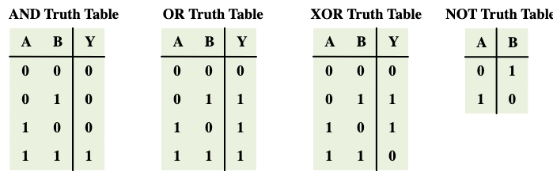
AND / OR
Used with Boolean expressions
Truth table: A table that defines the results of a binary operation

Slide 12
Casting
Converting one data type to another data type:
int(): Constructs an integer number casted from a string or a float
float(): Constructs a floating number from an integer or a float
str(): Constructs a string from a wide variety of data types
name = str(input("Please enter your Name: \n"))
age = int(input("Please enter your age: \n"))
height = float(input("Please enter your height in meters: \n"))
item = f"Hi, I'm {name} and {age} years old and {height} tall"
Please enter your name:
Maks
Please enter your age:
27
Please enter your height:
1.42
Hi, I'm Maks and 27 years old and 1.42 tall

Slide 13

Conditions:
if, elif, else

Slide 14
Conditions
if, is used when an action is required based on options.
Elif adds more conditions to be evaluated
else is when no if/elif are true
Only the first True condition is executed
user = "root"
pass = "toor"
if user == "root" and pass == "toor":
print("Welcome, you have root access")
else:
print("Wrong username or password")

Slide 15

Lab 1: Legal to Buy Redbull?
Ask the User for their Age.
Perform casting to convert Step 1 to int from str.
Create an if-else statement to verify the age: ex 18
Print result to User if they are allowed or not to buy

Slide 16
Lab 1: Legal to Buy Redbull?
1# Step 1 and 2
2 age = int(input("How old are you? "))
3 # step 3 and 4
4 if age >= 18:
5 print("You can buy RedNull")
6 else:
7 print("You are a minor so you can not buy it.")

Slide 17

Data Structures

Slide 18
List
Lists
Mutable - Read/Write
Start and End with [ ]
list1.append("Parrot")
list1.remove("Cat")
# Creating two lists
list1 = [10, 20, 30, 40]
# Printing the first and last elements of each list
print("First element of list1:", list1[0])
print("Last element of list1:", list1[-1])
print("Last element of list1:", list1[3])
10
40
40

Slide 19
Tuples
Tuple
Immutable - Read Only
Start and End with ( )
# Creating two lists
tuple1 = [10, 20, 30, 40]
# Printing the first and last elements of each list
print("First element of tuple1:", list1[0])
print("Last element of tuple1:", list1[-1])
print("Last element of tuple1:", list1[3])
10
40
40

Slide 20
Dictionary
Dictionary
Start and End with { }
Separate Keys and Values with colon :
personDict[“weight”] = 88
del personDict(“age”)
dictionary1 = {"San Diego": "California", "Date": "April 30th 2023"}
print(dictionary1)
print(dictionary1["San Diego"])
{'San Diego': 'California', 'Date': 'April 30th 2023'}
California

Slide 21

Lab 2: Services and Ports
Set up a dictionary with services and their port numbers.
Create a statement that asks the user for a service name.
Print the specified service and port number.

Slide 22
Lab 2: Services and Ports
# Dictionary of services and their port numbers
services = {
"http": 80,
"https": 443,
"ftp": 21,
"ssh": 22,
"smtp": 25,
"dns": 53 }
# Ask the user for a service name
service_name = input("Enter a service name: ")
# Check if the service name exists in the dictionary
if service_name in services:
print("Service:", service_name)
print("Port number:",services[service_name])
else:
print("Service not found.")

Slide 23
Split
Separation of a string into a collection of words
Split() separates a string and arranges it as a list.
The splitting point can be specified in the function.
string1 = "Hello World from Maks"
print(string1.split(" "))
print(string1.split("o"))
['Hello', 'World', 'from', 'Maks']
['Hell', ' W', 'rld fr', 'm Maks']

Slide 24
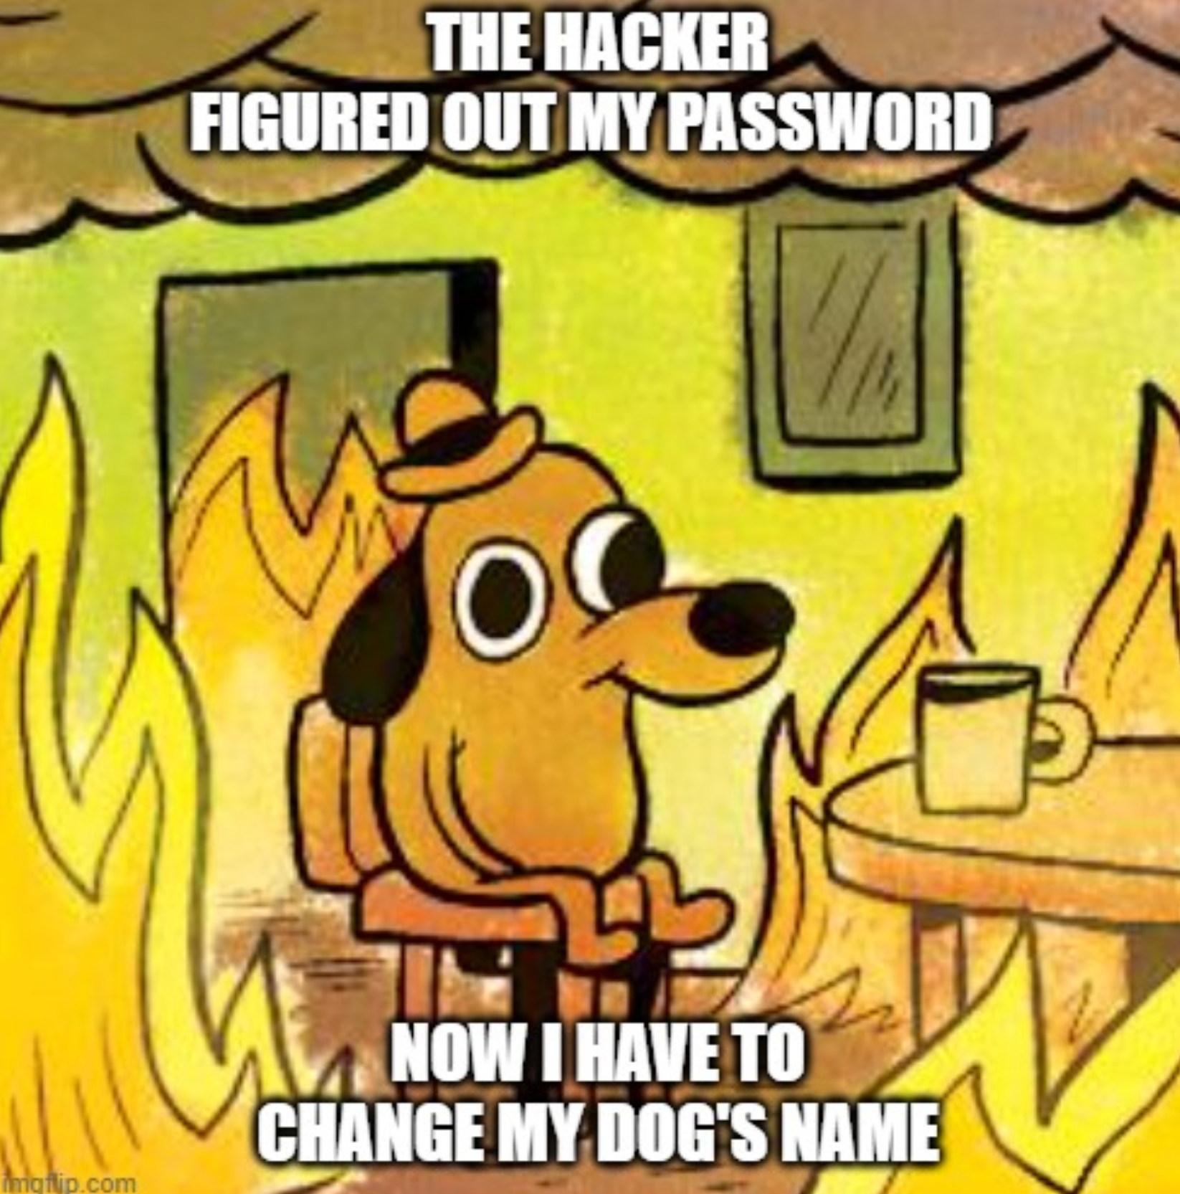
Loops

Slide 25
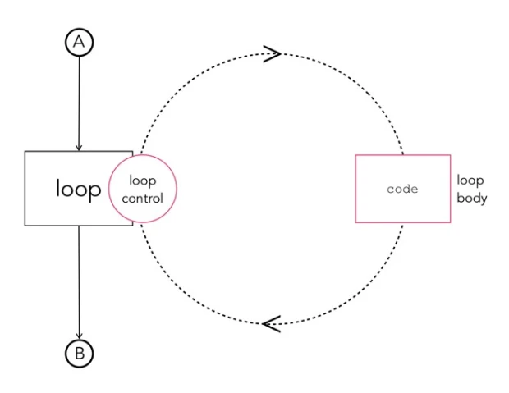
Loops
A loop is a sequence of instructions that repeat until a certain condition is met
For/While Loops
Usage:
Cycling through values
Adding sums of numbers
Repeating functions
Producing output
Searching for information

Slide 26
For Loops
Perform blocks of code
if the condition is true
A for loop provides iterating capabilities.
Can iterate over lists, defined ranges, and more
for Num in Numbers:
Loop (Iterate) through each element in Numbers data structure.
If Empty then loop does not run
# List of numbers
numbers = [1, 2, 3, 4, 5]
# Initialize sum
sum = 0
# Loop through each number in the list
for number in numbers:
sum += number # Add number to sum
print("Current number:", number, "Cumulative sum:", sum)
# Print the final sum
print("Total sum:", sum)

Slide 27
Loops
while loops
Perform a block of code while a condition is true
If the condition is false, the while loop will not be executed.
While loops do not have iteration capability like for loops.
# Initialize the counter
counter = 0
# Loop until the counter reaches 5
while counter < 5:
print("Current counter value:", counter)
counter += 1 # Increment the counter
print("Loop finished.")

Slide 28
Len() and range()
The len() function returns the number of items of an object.
Count the number of elements from Users Input
The range() function accepts an integer and returns the range of the object.
Used to loop through any data structure
# Example using len() with a list
my_list = [1, 2, 3, 4]
print("Length of the list:", len(my_list))
# Example using len() with a string
my_string = "hello"
print("Length of the string:", len(my_string))
# Example using range() in a for loop
for i in range(5): # Generates numbers from 0 to 4
print(i)
# Example using range() with start, stop, and step
for i in range(1, 10, 2): # Numbers from 1 to 9, stepping by 2
print(i)

Slide 29
Break, Continue, Pass
The break command exits a loop.
Pass means move on to the remaining code or loop body.
Continue forces the loop to begin the next iteration.
# Example using break in a loop
for number in range(1, 10):
if number == 5:
break # Exit the loop if number is 5
print(number)
print("Loop ended after hitting break.")
# Example using pass in a loop
for number in range(1, 10):
if number % 2 == 0:
pass # Do nothing for even numbers
else:
print(number)
print("Only odd numbers are printed.")
# Example using continue in a loop
for number in range(1, 10):
if number % 2 == 0:
continue # Skip the rest of the loop for even numbers
print(number)
print("Skipped even numbers and printed odd numbers.")

Slide 30
Lab 3: Grocery Shopping
Create Dictionary with Item name and Cost: “redbull”: 5
Create a Budget variable: budget = 20 # 20 Dollars
Ask User what they want to buy
Subtract from Budget and Add to Cart
If user types Exit then break program
Print Quantity and Name of Product:
3 Apples
2 Lemons
50 Dollars left

Slide 31
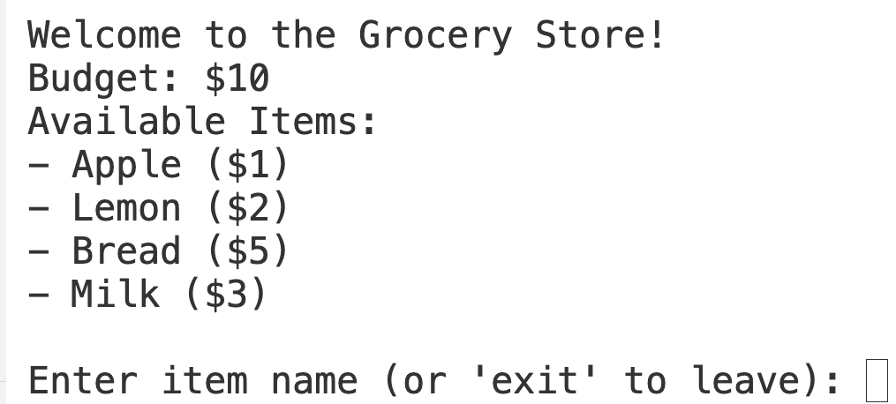
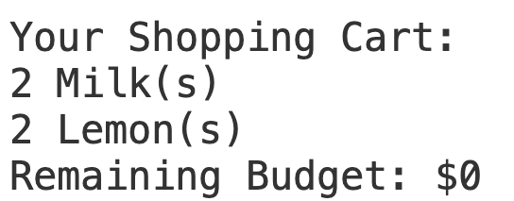
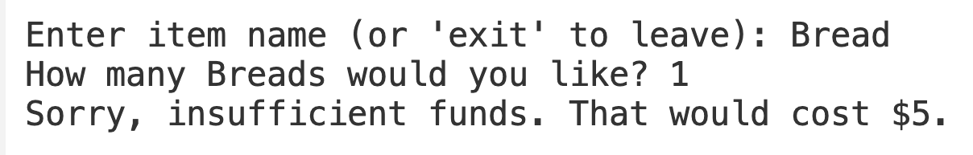
Lab 3: Grocery Shopping
Solution

Slide 32
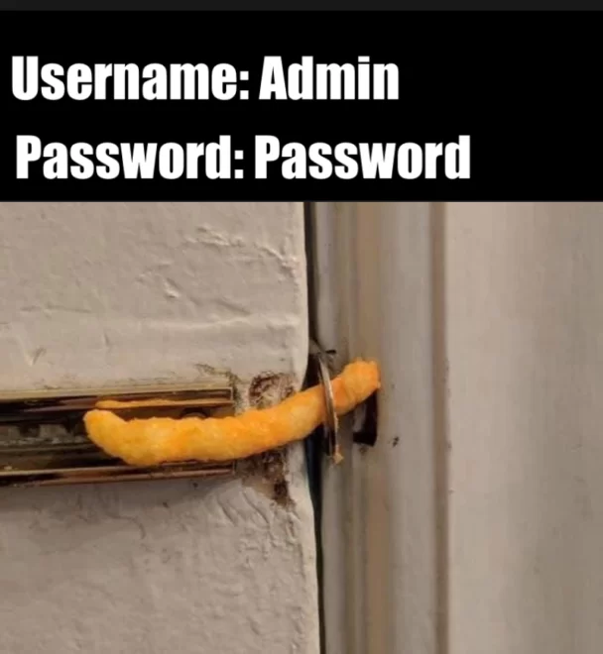
Error Handling

Slide 33
Errors in Python
Python programs may encounter errors and raise exceptions.
If not handled, the program stops and presents an error.
Error handling can prevent a crash and allow the script to continue functioning.
print(1/0)
ZeroDivisionError: division by zero

Slide 34
Errors in Python
Error messages explain the reason for a crash.
try creates a code block to execute code that may create an error.
except handles the error in the try code.
try:
print(1/0)
except(ZeroDivisionError):
print("Can not divide by zero!!!")
except:
print("Some Error Happened")
Can not divide by zero!!!

Slide 35
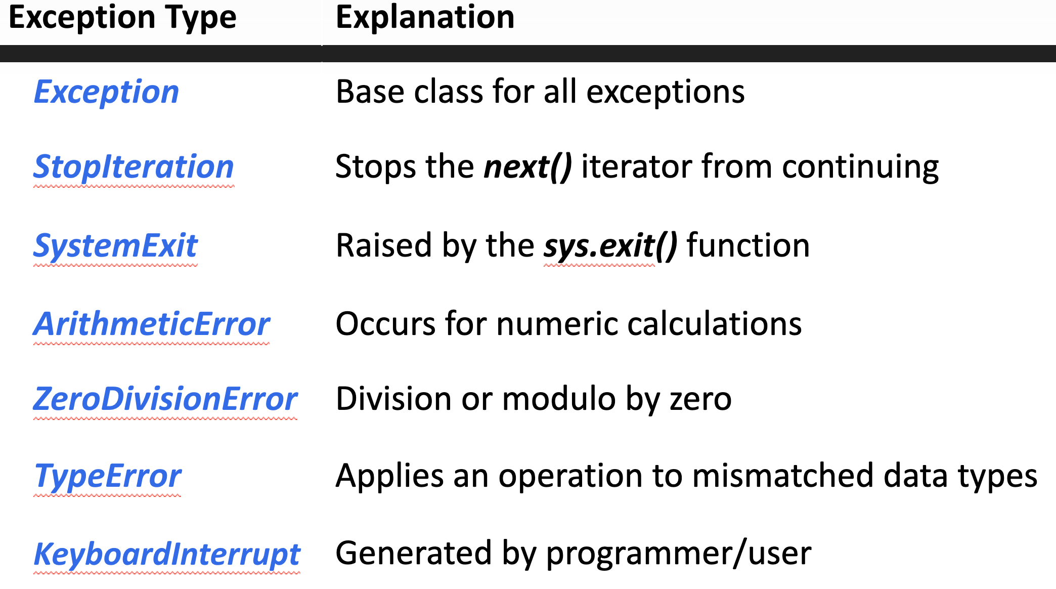
Errors in Python

Slide 36
Errors in Python
Exception as error: Inserts an error message in a variable
Raise: Prints a custom error message
Else: Runs only if no exception occurred
Finally: Runs whether the code failed or succeeded
try:
result = x / y
except ZeroDivisionError as error:
# Handling division by zero
print("Cannot divide by zero!", error)
except TypeError as error:
# Handling incorrect input types (e.g., if one is not a number)
print("Please provide numbers only!:", error)
else:
# This block runs only if there were no exceptions
print("Result is", result)
finally:
# This block runs whether or not there was an exception
print("Executing finally clause")

Slide 37

Lab 4: Four Loops
Create an iteration of 4 loops.
Ask the user for a number every time
Multiply all the numbers
Handle potential errors.

Slide 38
Lab 4: Four Loops
product = 1 # Initialize product to 1 for multiplication
for _ in range(4): # Loop four times using throwaway variable "_"
while True: # Loop for valid input
try:
number = float(input("Enter a number: "))
product *= number # Multiply the product by the current number
break # Exit the inner loop if input is valid
except ValueError:
print("Invalid input. Please enter a number.")
print(f"The product of all numbers is: {product}")

Slide 39
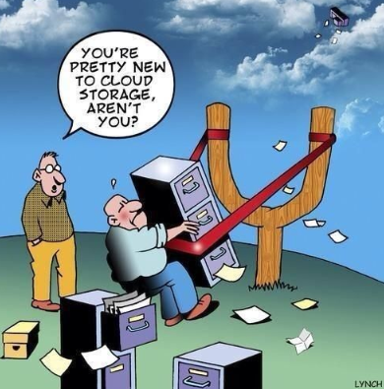
Reading/Writing to Files

Slide 40

Python & Files
Python includes several built-in modules and functions for file handling.
In Python, a file is categorized as either text or binary.
Binary files are processed only by applications that work with the binary structure.

Slide 41
Python & Files
Mode | Description
r | Opens a file for reading only
a | Opens a file for appending; creates a new file if it does not exist
w | Opens a file for writing only and overwrites the existing file
+ | Adds a read or write operation depending on the one selected
b | Opens a file in binary format

Slide 42
Python & Files
A with statement will create a context manager.
The open() function sets a new variable to handle the file.
The variable that contains the file is the one defined after as.
with open("file.txt", "w") as file:
file.write("hello from with open statements")
with open("file.txt", "r") as file:
data = file.read()
print(data)
===================================
hello from with open statements

Slide 43

Lab 5: Infinite Files
Write User input to a File
Use Error Handling Try/Except
Infinite loop to take user input
Break the loop if the word exit is entered.
Read file and print after

Slide 44
Lab 5: Infinite Files
with open("my_file.txt", "a") as file: # Open the file in append mode ('a')
while True:
text = input("Enter text to write (type 'exit' to stop): ") # Get user input
if text.lower() == "exit": # Check for exit condition
break
file.write(text + "\n") # Write text to the file and Add newline character for each line
print("Text successfully written to the file!")
except Exception as e:
print("An error occurred:", e)

Slide 45

Modules & Libraries

Slide 46

Python Modules/Libraries
Python source files
Contain Python entities and functionalities
Can be imported and used in Python files
Used to break down large programs into smaller, more easily managed files

Slide 47

Pypi.org

Slide 48
Python Modules/Libraries
The OS module in Python provides various ways of working with the operating system.
OS module can let you run system commands
import os
os.system("ping 8.8.8.8")
Pinging 8.8.8.8 with 32 bytes of data:
Reply from 8.8.8.8: bytes=32 time=61ms TTL=51
Reply from 8.8.8.8: bytes=32 time=61ms TTL=51
Reply from 8.8.8.8: bytes=32 time=60ms TTL=51
Reply from 8.8.8.8: bytes=32 time=61ms TTL=51
------------------------------------------------------
Ping statistics for 8.8.8.8:
Packets: Sent = 4, Received = 4, Lost = 0 (0% loss),
Approximate round trip times in milli-seconds:
Minimum = 6ms, Maximum = 8ms, Average = 7ms

Slide 49
OS Module
The os.listdir(path) function lists all
the files in the specified directory.
The r before the directory instructs the interpreter to regard the characters that follow as a raw string.
import os
print(os.listdir())
=========================================
['file', 'pingTest.txt', 'try.py', 'users’]
Process finished with exit code 0

Slide 50
OS Module
The os.chdir() function changes the working directory.
The os.mkdir() function creates a directory.
The os.rmdir() function removes a directory.
The os.rename() function renames a file.
#change the current path
os.chdir(path)
#create a new directory
os.mkdir(newName)
#delete a directory
os.rmdir(deleteDirName)
#rename the file
os.rename(oldName.txt, newName.txt)

Slide 51
Python check internet connection
Check if Device has internet connectivity
Useful for Malware
import os
os.system("ping 8.8.8.8 >> pingTest.txt")
with open("pingTest.txt", "r") as file:
for line in file:
if "ms" in line:
print("You have an internet connection.")
break
elif "unreachable" in line:
print("You do not have an internet connection.")
else:
continue
===========================================================
You have an internet connection

Slide 52
Datetime
The datetime module includes classes for date and time.
It provides functions that handle the time, date, and time intervals.
import datetime​
​
print("current date is{}".format(datetime.datetime.now()))​
h = datetime.datetime.now().hour​
m = datetime.datetime.now().minute​
s = datetime.datetime.now().second​
print("current date is {}:{}:{}".format(h,m,s))​
​
============================================
current date is 2022-05-03 19:37:07.282371​
current date is 19:37:7

Slide 53
Platform
The platform module is used to access data related to the OS and hardware.
Use the platform module to get information about a machine.
import platform
print("\n processer name is -> {}".format(platform.processor()))
print("\n python compiler is -> {}".format(platform.python_compiler()))
print("\n operation system is -> {}".format(platform.system()))
print("\n OS version is -> {}".format(platform.version()))
print("\n OS architecture is -> {}".format(platform.architecture()))
-------------------------------------------------------------------------------------
processor name is -> Intel64 Family 6 Model 141 Stepping 1, Genuine Intel
python compiler is -> MSC v.1929 64 bit (AMD64)
operation system is -> Windows
OS version is -> 10.0.22000
OS architecture is -> ('64bit', 'WindowsPE’)

Slide 54
Random
The random module enables the generation of pseudo-random numbers.
random.randint(x,y) returns a random integer in the range that appears in parentheses.
import random
While True:
user_guess = int(input("Guess a number between 1 and 10: "))
randG = random.randint(1,10)
if randG != user_guess:
print("Wrong guess, the number is: {}".format(randG))
else:
print("Congrats, you guessed the number!")
-----------------------------------------------------------------------------------------
Guess a number between 1 and 10: 5
Wrong guess, the number is: 9
Guess a number between 1 and 10: 4
Congrats, you guessed the number!

Slide 55
Parsing
with open("log.txt","r") as file:
for line in file:
if "ftp" in line:
parsed = line.split(" ")
print("Date:{}, OS:{}".format(parsed[0],parsed[1]))
-------------------------------------------------------
Date: 01/01/22, OS: macOS
Date: 01/01/22, OS: win10
Source File:
01/01/22, macOS, 192.168.88.2, TCP, 22
01/01/22, win10, 192.168.88.2, TCP, 22

Slide 56
Lab 6: Parsing Firewall Logs
1. Parse the “Lab 6: Log File.txt?” file (Labs Github Folder)
2. Print each data field with a description example:
Source IP: 192.168.1.1
Action: Deny​
3. Bonus: How many SSH destination sites were blocked

Slide 57
Lab 6: Parsing Firewall Logs
Timestamp: 2024-01-29 15:32:36
Source IP: 10.0.0.15
Zone: INTERNAL
Action: ALLOW
Direction: inbound
Destination: admin.example.com
There were 3 logs entries that were SSH destination and Blocked

Slide 58
Lab 7: Base64
Import the Base64 library.
Get a secret from the user.
Encode and print the secret.
Decode and print the secret

Slide 59
Lab 7: Base64
import base64
# Get secret from user
secret = input("Enter your secret message: ")
# Encode the secret
encoded_secret = base64.b64encode(secret.encode("utf-8")).decode("utf-8")
print(f"Encoded Secret: {encoded_secret}")
# Decode the secret
decoded_secret = base64.b64decode(encoded_secret.encode("utf-8")).decode("utf-8")
print(f"Decoded Secret: {decoded_secret}")

Slide 60

Functions

Slide 61

Functions
Functions are necessary to prevent code from becoming difficult to understand.
They save the time and effort of having to write the same functional code in different parts of a program.
They also make code maintenance more efficient.
Blocks of code with reusable logic
Separate programs into small, readable, and manageable sections.

Slide 62
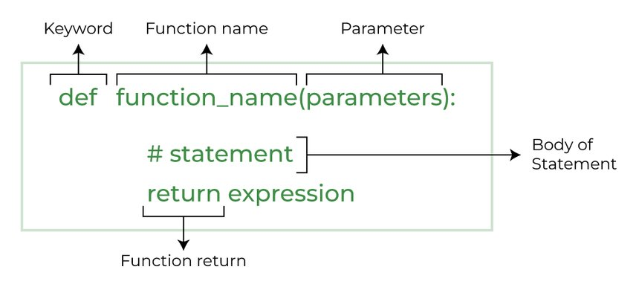
Functions
def Print_Multiple(message, times = 1):
for i in range(times):
print(message)
Print_Multiple("Hello", 2)
Print_Multiple("Hi!")

Slide 63
Functions
Functions can pass data at the end of the execution.
The return keyword is used to pass the values.
return also terminates the execution of a function.
def Calculation(x, y):
answer = x + y
return answer
Result = Calculation(2, 4)
print(result)
Result2 = result * 2

Slide 64
Lab 8: Calculator
Receive 2 User numbers and 1 Operation (+,-,*, /)
Define basic operations functions.
Define the main function.
Run the correct function according to users operation
def addition(x, y):
answer = x + y
return answer
def multiplication(x, y):
answer = x * y
return answer

Slide 65
Lab 8: Calculator
Receive 2 User numbers and 1 Operation (+,-,*, /)
Define basic operations functions.
Define the main function.
Run the correct function according to users operation
def addition(x, y):
answer = x + y
return answer
def multiplication(x, y):
answer = x * y
return answer

Slide 66

Networking
and Sockets

Slide 67
Python Socket
The endpoint of a connection between two communicating parties
Consists of an:
Source/Destination IP address
Protocol
Source Destination port
The socket library is part of Python’s standard library.
The library allows creation of sockets for connection and listening purposes.

Slide 68
Python Socket
Two objects are returned when a connection is accepted: a socket and an IP address.
A connection should be closed when the communication ends.
import socket
new_socket = socket.socket()
new_socket.bind(("0.0.0.0", 50000))
new_socket.listen(4)
conn, addr = new_socket.accept()
new_socket.close()

Slide 69
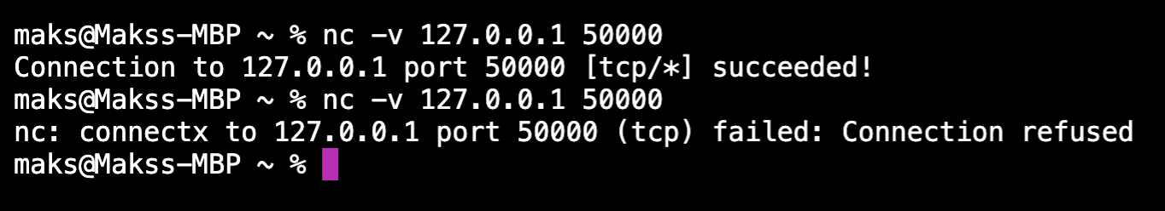
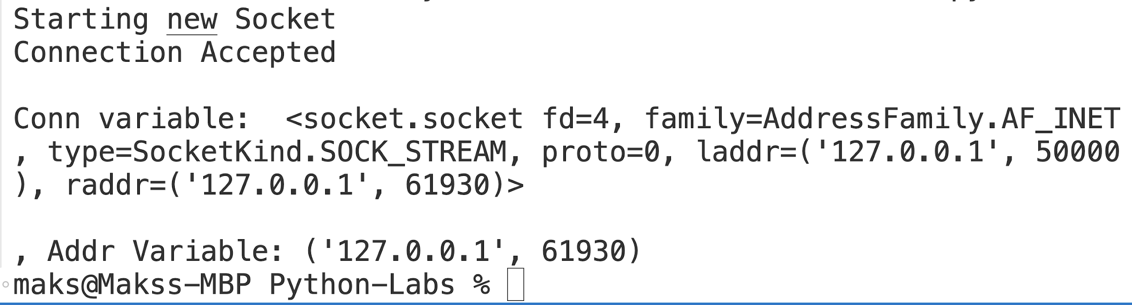
Test Server with Netcat
nc –v IP PORT

Slide 70
Client Socket
Connect to IP and Port as a Tuple
Try/Except
If Statements
Loops
import socket
new_socket = socket.socket()
new_socket.connect(("10.0.0.5", 50000))
new_socket.close()

Slide 71
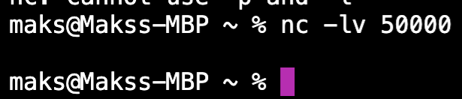
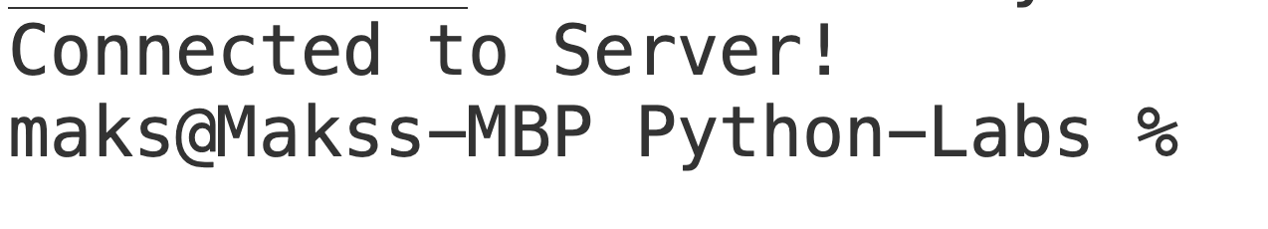
Client Socket Netcat
Nc –lv 50000

Slide 72
Sending data
Data sent between a client and server must be encoded.
Encoding is required because a socket can only accept bytes.
import socket
new_socket = socket.socket()
new_socket.connect(("10.0.0.5", 50000))
new_socket.send("Hello from the other side".encode())
new_socket.close()

Slide 73
Receiving data Server
Python’s socket can also accept data from a client.
A byte limitation (buffer) needs to be set for all data received.
The accepted data must be decoded to get the human-readable representation.
import socket
new_socket = socket.socket()
new_socket.bind((“0.0.0.0", 50000))
new_socket.listen(4)
conn, addr = new_socket.accept()
data = conn.recv(2048).decode()
print(data)
new_socket.close()
-------------------------------------
Hello from the other side

Slide 74
Receiving data Client Side
A server typically also sends data to clients.
Clients receive the data similarly to how the server receives data.
import socket
new_socket = socket.socket()
new_socket.settimeout(5.0)
new_socket.connect((“10.0.0.5", 50000))
data = new_socket.recv(2048).decode()
print(data)
except socket.timeout:
print("Timed out waiting for data")
new_socket.close()
--------------------------------------
Hello from server

Slide 75
Lab 9: Login via Sockets
Pick a Partner to be Server or Client
Client Connect to Server
Server Ask Client for Username & Client sends username
Server asks for password & Client Sends password
Server compares Username & Password to Known Credentials and Authenticates (Passwords in Variable or from File on Server)
If correct, Servers says “Login Successful “
If wrong, Server tells client “Wrong Credentials”
Run Wireshark and view the Traffic!
BONUS: Hash Password to hide it from network

Slide 76
Lab 10 - Login Sniffing
Download Client.py and Server.py
Run but don’t look at Server.py code
Goal is to get credentials from Packet Capture and login to receive the flag from the server
Hint:
You should edit Client.py only
Wireshark is a great resource

Slide 77
Lab 11: Chat Room - Brute Force
Download whole Lab 11 Folder.
Run Server.py and Client.py
Goal is to create a python script that brute forces the login on Server.py with Wordlist file
For easier attempt look at the Server.py code

Slide 78
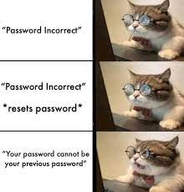
Command and Control(C2)
&
Botnet Topologies

Slide 79
C2 and Botnets
C2, C&C, Command and Control: networks are secure communication systems that enable commanders and managers to issue instructions, receive data, and maintain situational awareness over geographically dispersed end points.
A botnet is a group of Internet-connected devices, each of which runs one or more bots. The owner can control the botnet using command and control software.

Slide 80
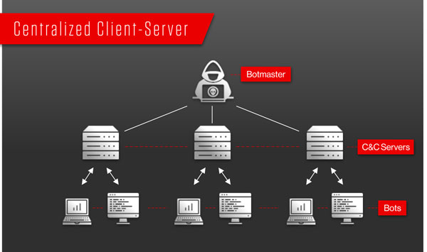
C2 and Botnets
Multi-server: in which there are multiple C&C servers for redundancy in case one is disabled.
Hierarchical: in which multiple C&C servers are organized into tiered groups to increase reliability.
Possible to parcel out groups of bots for rental to different clients.
Reduces the number of machines that could be discoverable from the detection of a single group or bot.

Slide 81
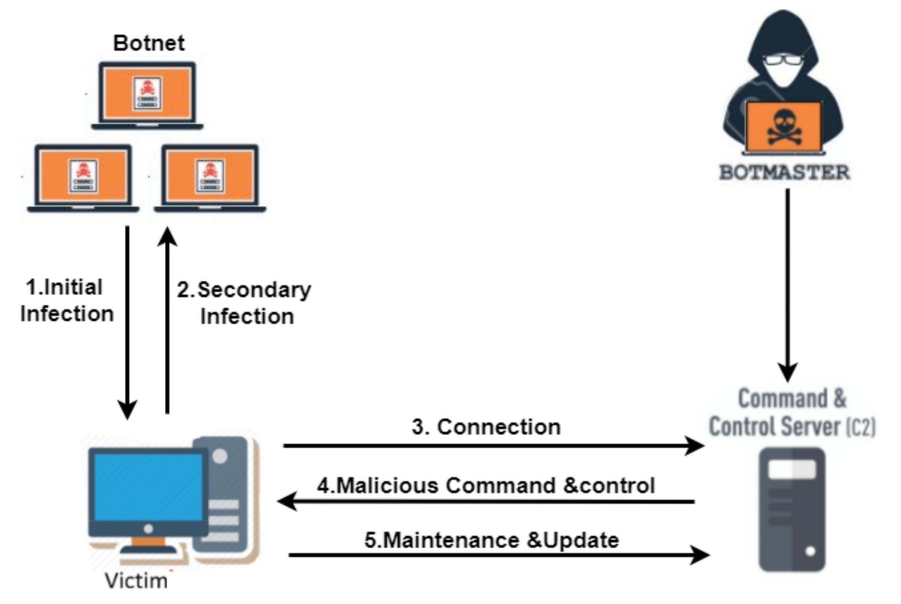
C2 and Botnets
Random, in which there is no C&C server at all and bots communicate peer-to-peer (P2P botnet), with more advanced botnets using encryption.
As a resiliency measure, some non-random botnets are designed to reorganize as a P2P botnet in the event that a C&C server is taken down
Evolving Strategies: Botmasters often evolve their botnet architectures to counter cybersecurity measures, leading to more complex and hybrid approaches that blend various topologies to optimize resilience and control.

Slide 82
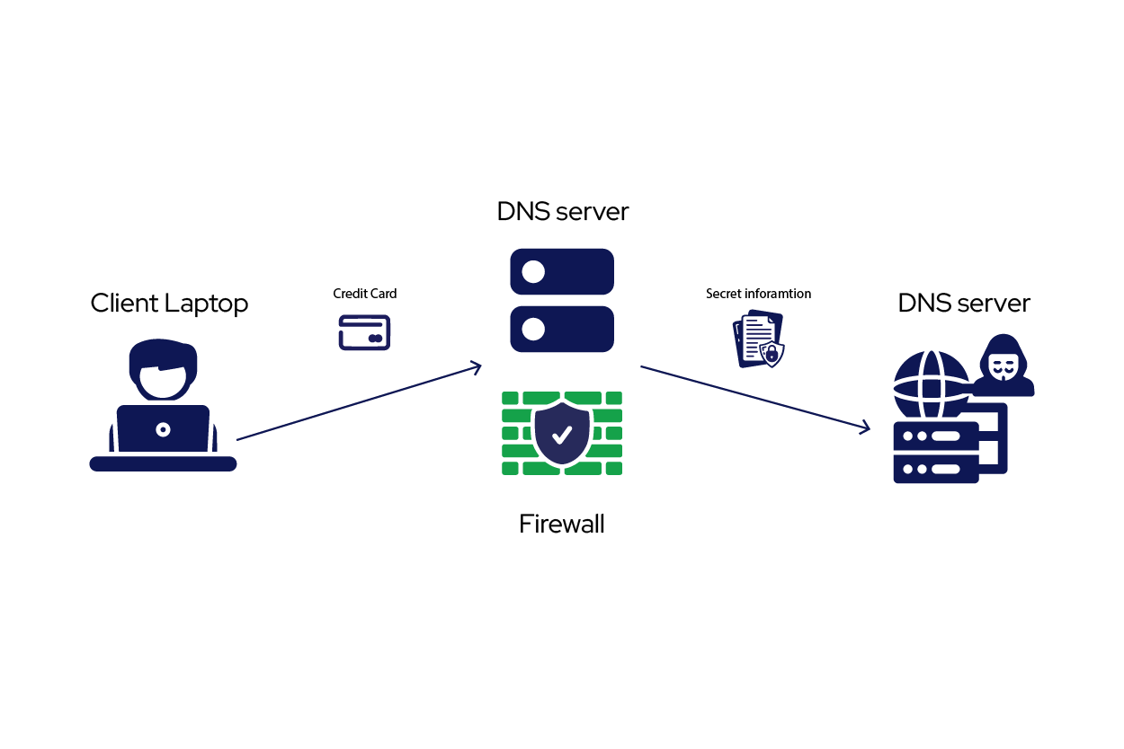
C2 Communication Channels
Application Layer Protocols: Leveraging standard protocols like HTTP/HTTPS disguised as legitimate traffic.
Non-Application Layer Protocols: Utilizing network protocols like ICMP (ping) or DNS requests for data transfer.
Social Media and Cloud Services: Abusing platforms like social media or cloud storage for hidden communication channels.
Multi-Stage Channels: Employing a series of communication channels to mask the origin and destination of C2 traffic.

Slide 83
SMTP C2 via Python
# Email sender and recipient
sender_email = "your-email@example.com"
receiver_email = "receiver-email@example.com"
# Email subject and body
subject = "Hello from Python"
body = "This is a test email sent from a Python script."
# SMTP server details
smtp_server = "smtp.example.com"
smtp_port = 587 # For SSL use 465, for TLS use 587
smtp_username = "your-email@example.com"
smtp_password = "your-email-password"
# Connect to the SMTP server and send the email
try:
server = smtplib.SMTP(smtp_server, smtp_port)
server.starttls() # Secure the connection
server.login(smtp_username, smtp_password)
server.sendmail(sender_email, receiver_email, message.as_string())
print("Email successfully sent!")
except Exception as e:
print(f"Failed to send email: {e}")

Slide 84
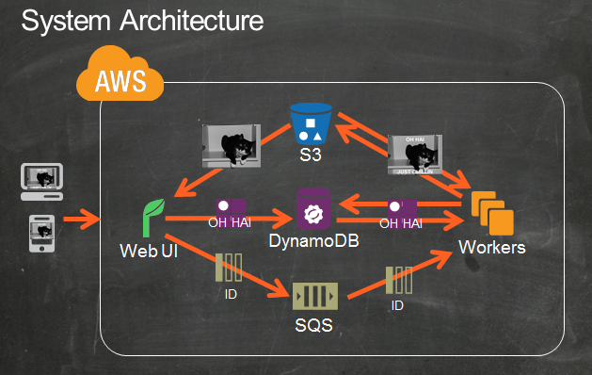
Host C2 on AWS

Slide 85
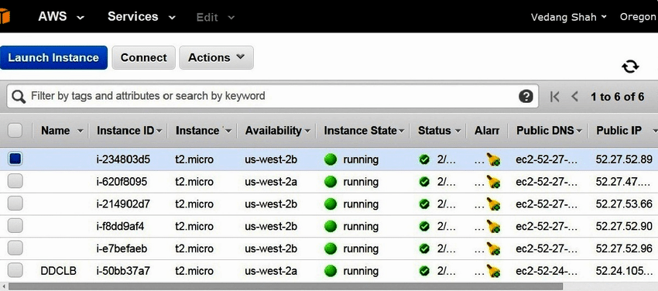
AWS EC2
On-Demand Cloud Computing: Spin up virtual servers in seconds, with a wide range of configurations to choose from.
Scalability: Easily scale your compute resources up or down to meet changing demands.
Pay-As-You-Go: Only pay for the compute resources you use.
Global Reach: Deploy your applications across a vast global infrastructure with multiple regions and Availability Zones.
Notes:
EC2 is simple way of makgin botnet on AWS, there are way more complex wayslike Step functions/ApI Gateway

Slide 86
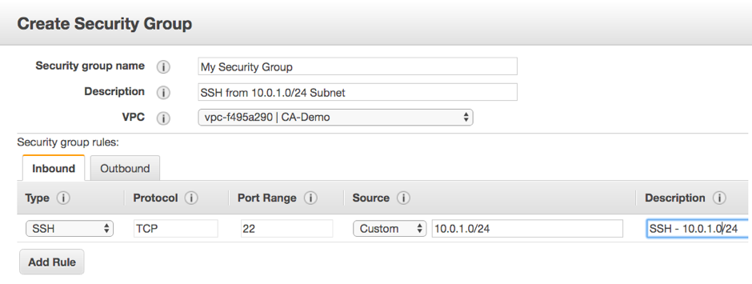
Control Network Traffic with Security Groups
Firewall in the Cloud: Security groups act as virtual firewalls, controlling inbound and outbound traffic to your EC2 instances.
Granular Control: Define security rules to specify which ports are open and who can access them.
Multiple Security Groups: Assign multiple security groups to an instance for layered security.
Best Practices: Follow the principle of least privilege, only opening the ports your application needs.

Slide 87
Features of a Botnet
Data Exfiltration:
Keylogging: Capture keystrokes entered on the endpoint, potentially grabbing passwords or sensitive information.
Screenshotting: Take screenshots of the endpoint's screen to steal visual data.
File Transfer: Upload or download specific files from the endpoint to a central server controlled by the botnet operator.
System Exploitation:
Installing Malware: Download and install additional malware onto the endpoint, expanding the botnet's functionality or causing further damage.
Denial of Service (DoS) Functionality: Turn the endpoint into a mini-attacker, flooding targets with traffic as instructed by the botnet controller.

Slide 88
Features of a Botnet
Resource Disruption:
Cryptojacking: Utilize the endpoint's processing power to mine cryptocurrency for the botnet operator's benefit.
Spam Relaying: Turn the endpoint into a spam server, sending out massive amounts of spam emails under the radar.
Information Gathering:
Network Sniffing: Monitor network traffic flowing through the endpoint, potentially capturing login credentials or other sensitive data.
System Information Gathering: Collect data about the endpoint's hardware, software configuration, and running processes.

Slide 89
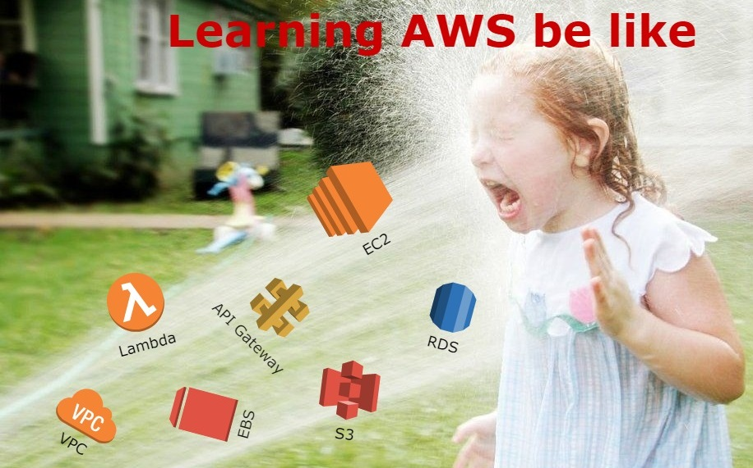
Deploying C2 Infrastructure on AWS

Slide 90
Deploying C2 Infrastructure on AWS
Chose EC2 OS to host Botnet server. Ex: ubuntu
Allow Ports via Security Group and host based Firewall. Ex: SSH
Remotely connect to EC2 via SSH/VNC
Deploy C2 Server.py on EC2 via Git Clone
Run Server.py and test/troubleshoot networking
Deploy Client.py on test endpoint either Local, VM or another EC2
Test Botnet Features
Bonus: Do a packet capture
To See and Learn how features work/look like
Familiarity when seeing similar actions in the wild

Slide 91

Bonus: Deploy C2 infrastructure with redundancy
Networking
Embed multiple IP’s/Domains for C2 communication in case they get taken down
Implement DGA - Domain Generation Algorithm
Obfuscate/Encrypt communication for more difficult detection (Solarwinds Example)
Server Side
Multiple EC2 servers for redundancy
Side Channel communication
Example: SMTP server via Gmail.
Server.py sends email to SMTP
Client.py checks email and runs commands

Slide 92

How to Detect C2 in Malware

Slide 93
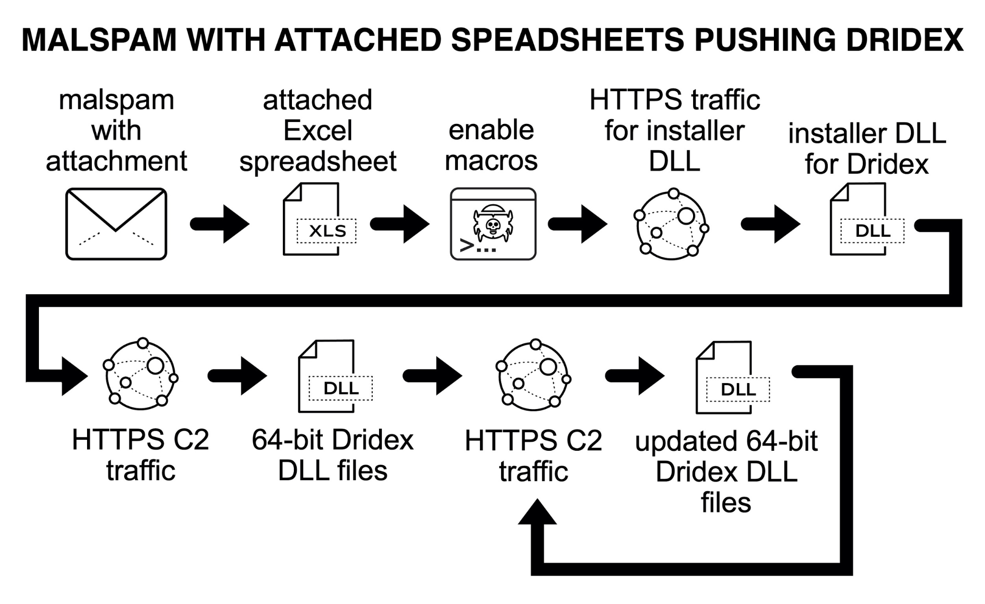
C2 Malware Stages

Slide 94
How to Detect C2 in Malware
Network Traffic Analysis:
Monitoring DNS Requests: Malicious software often uses DNS requests to communicate with C2 servers. Analyzing these requests for suspicious domain names, newly registered domains, or frequent lookups for specific IP addresses can be a red flag.
Deep Packet Inspection (DPI): Examining the content of network packets can reveal hidden communication within seemingly normal protocols like HTTP or HTTPS. Tools can look for specific patterns or keywords associated with known C2 protocols.
Port Monitoring: Certain ports are commonly used for C2 communication, such as port 443 (HTTPS) or custom ports defined by the malware. Monitoring inbound and outbound traffic on these ports can be helpful, but malware can use encryption or switch ports to evade detection.

Slide 95
How to Detect C2 in Malware
Behavioral Analysis:
Unusual Network Activity: Sudden spikes in network traffic, frequent connections to unknown IP addresses, or connections to geographically distant locations can indicate C2 communication.
Process Monitoring: Observing processes on the infected device for suspicious behavior like abnormal file access patterns, communication with known C2 domains, or attempts to obfuscate network activity.
Sandboxing: Running suspected malware in a secure isolated environment allows for analyzing its network communication without risking a real-world infection.
Sharing Information: Sharing information about new threats can help prepare for and identify C2 patterns more quickly.

Slide 96
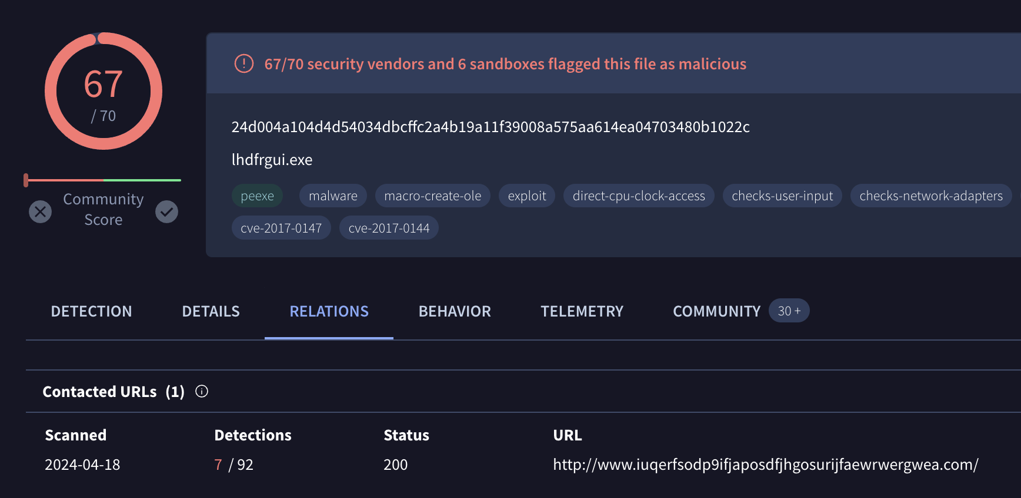
How to Detect C2 in Malware via Virustotal - WannaCry

Slide 97
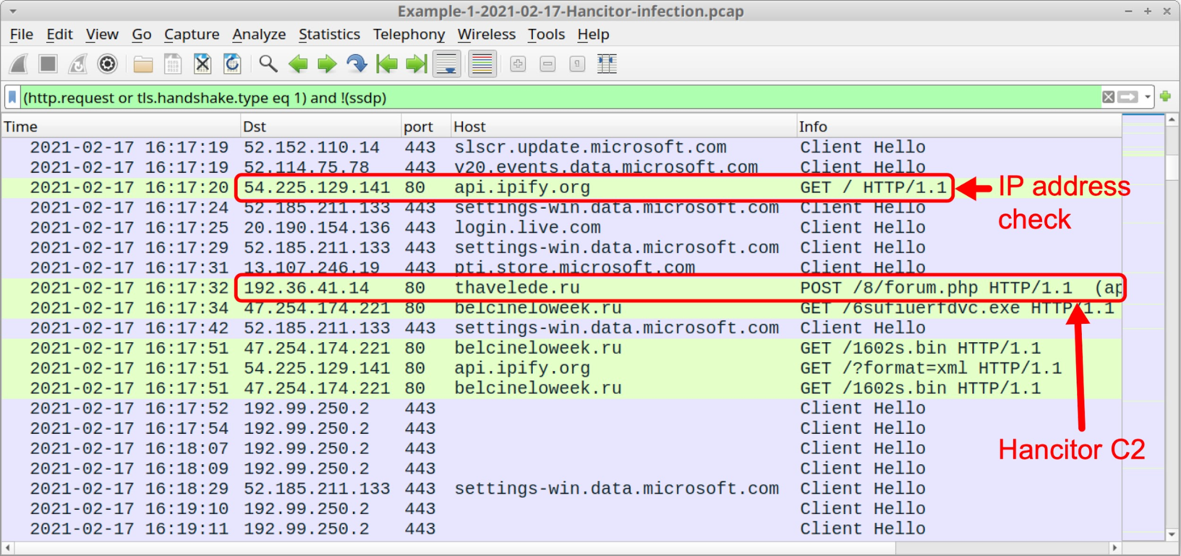
How to Detect C2 in Malware via Wireshark

Slide 98
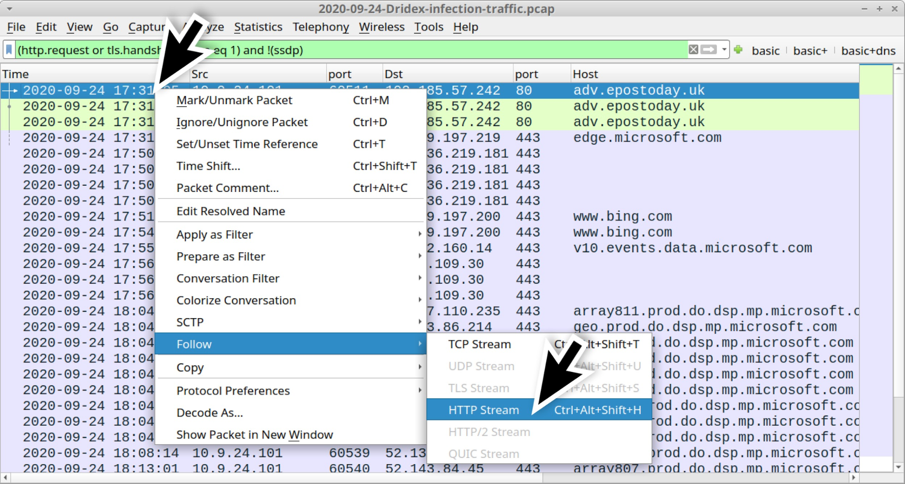
Follow HTTP Stream

Slide 99
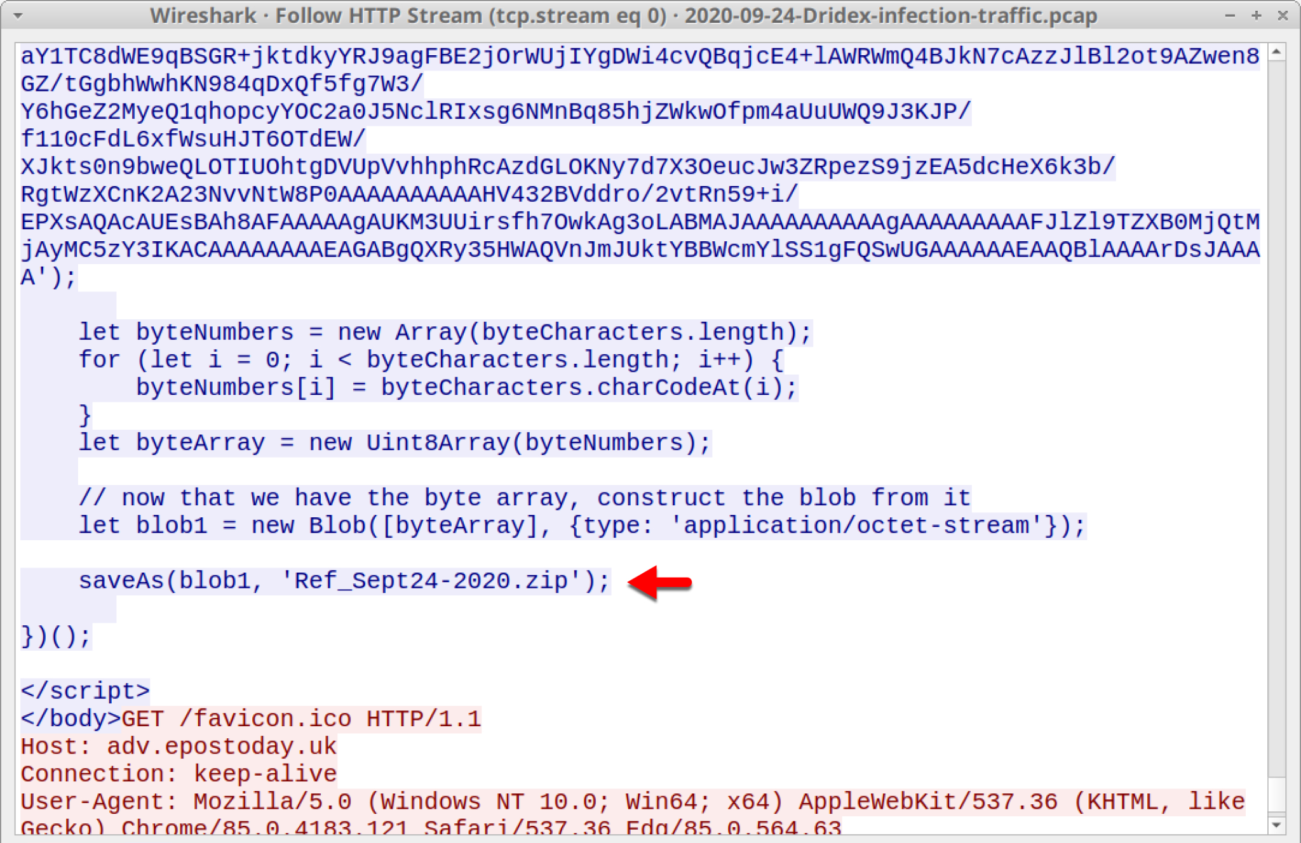
Investigate HTTP FLow

Slide 100
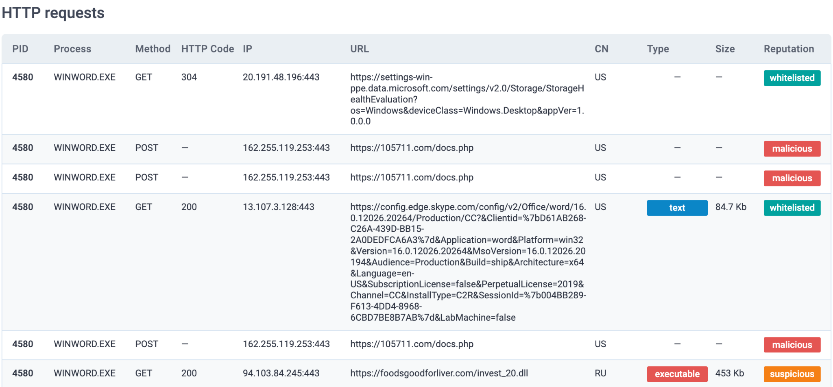
Detect C2 via Online Sandbox ex: any.run

Slide 101
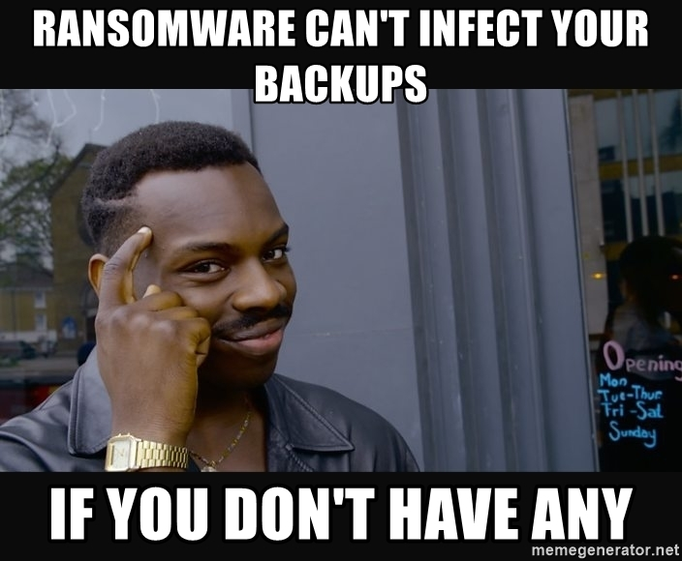
How to block C2 on local networks

Slide 102
How to block C2 on local networks
Firewalls: Configure firewalls to block inbound and outbound traffic to known C2 server IP addresses and ports.
Utilize threat intelligence feeds to keep your firewall rules updated with the latest malicious domains and IPs.
Intrusion Detection/Prevention Systems (IDS/IPS): Deploy IDS/IPS systems to monitor network traffic for suspicious activity patterns associated with C2 communication and botnet behavior. These systems can automatically block or alert you of potential threats.
EDR Systems: Implement an EDR solution to monitor, detect, and respond to threats on endpoints. EDR can identify and mitigate threats that bypass other security measures.

Slide 103
How to block C2 on local networks
Antivirus and Anti-Malware Software: Keep all devices on your network protected with up-to-date antivirus and anti-malware software to detect and remove malware that attempts to establish C2 communication.
Application Whitelisting: Consider implementing application whitelisting to restrict endpoint execution to only authorized applications, preventing the installation of malicious software that could connect to a C2 server.
DNS Filtering Services: Utilize DNS filtering services that can block access to known malicious domains commonly used by C2 servers. This can prevent initial infection attempts and disrupt C2 communication for existing botnet members.

Slide 104

How Governments/Big Tech take down Global C2 networks

Slide 105
How Governments/Big Tech take down Global C2 networks
Government Actions:
Law Enforcement Investigations: This might involve international cooperation, following financial trails, and gathering evidence for potential prosecution.
Disrupting C2 Infrastructure: Through legal channels or covert operations, governments might attempt to seize control of C2 server infrastructure or disrupt their communication channels.
Sharing Threat Intelligence: Governments can share information about known C2 infrastructure and communication patterns with Big Tech companies and other countries to aid in broader disruption efforts.
Legal Frameworks and Regulation: Governments can develop legal frameworks and regulations that hold internet service providers (ISPs) and Big Tech companies accountable for identifying and disrupting malicious C2 activity within their networks.

Slide 106
Operation Tovar (2014) - GameOver Zeus Botnet
Government Participants:
the US-CERT
Australian Federal Police
the National Police of the Netherlands
European Cybercrime Centre (EC3)
Germany’s Bundeskriminalamt
France’s Police Judiciaire
Italy’s Polizia Postale e delle Comunicazioni
Japan’s National Police Agency
Luxembourg’s Police Grand Ducale
New Zealand Police
the Royal Canadian Mounted Police
Ukraine’s Ministry of Internal Affairs
the United Kingdom’s National Crime Agency
U.S. Department of Defense
Tech Participants:
Dell SecureWorks
CrowdStrike
Microsoft
Afilias
F-Secure
Level 3 Communications
McAfee
Shadowserver
Anubis Networks
Symantec
Heimdal Security
Sophos
Trend Micro
Carnegie Mellon University
Georgia Institute of Technology (Georgia Tech).

Slide 107

Operation Tovar (2014) - GameOver Zeus Botnet
GameOver Zeus was a notorious botnet known for banking fraud and distributing the CryptoLocker ransomware.
The takedown involved:
seizing servers
sinkholing the botnet domains
Redirecting the traffic from infected machines to servers controlled by law enforcement.
DGA - Domain Generation Algorithm was cracked
Malware used to connect to an ever-changing list of malicious servers

Slide 108
Let’s Get Started:
Building out Botnet/C2

Slide 109
Let’s Get Started building out Botnet/C2 Features
Botnet Name: ?????
3 Teams based by Function:
Server Environment:
AWS EC2, Security Groups, Github pipeline, etc
C2 Channel
How the client and server will communicate. ex : Python Socket Tunnel, SMTP, or DNS.
Botnet Features
All features the botnet should have

Slide 110
Let’s Get Started!
Start Programing Botnet Features: All the Code should be a function with returns:
System Information Gathering: Collect data about the endpoint's hardware, software configuration, and running processes.
Screenshotting: Take screenshots of the endpoint's screen to steal visual data.
File Transfer: Upload or download specific files from the endpoint to a central server controlled by the botnet operator.
Installing Malware: Download and install additional malware onto the endpoint, expanding the botnet's functionality or causing further damage.
Keylogging: Capture keystrokes entered on the endpoint, potentially grabbing passwords or sensitive information.
Remote Shell: Ability to get CMD/Terminal and run commands directly as if physically in front of device

Slide 111
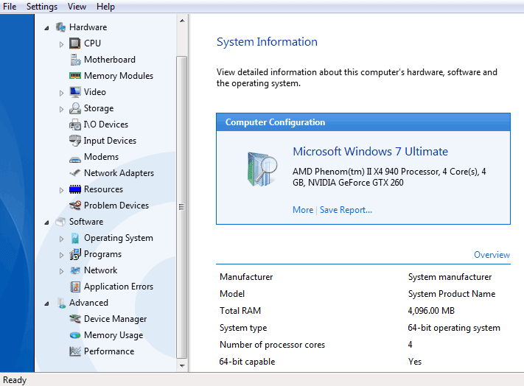
Example Feature: System Information Gathering (SIM)
Specifics for INFO module to gather:
IP Address
Available/Used
Memory
Hard Drive
CPU
Operating System
Version of OS
Programs Installed
Processes currently running
AV’s installed

Slide 112
Example Feature: System Information Gathering
def gather_system_information():
# SIM_A_3_4 Get basic OS information
info['system'] = platform.system()
info['processor'] = platform.processor()
# Get memory details
info['total_memory'] = memory.total
info['available_memory'] = memory.available
# List all running processes
for proc in psutil.process_iter(['pid', 'name']):
processes.append(proc.info)
info['processes'] = processes
# Return all gathered info
return SIM
SAMPLE OUTPUT
{
"system": "Linux",
"node_name": "example-host",
"version": "#46-Ubuntu SMP Fri Jul 10 00:24:02 UTC 2020",
"processor": "x86_64",
"total_memory": 16712351744,
"available_memory": 12298874880,
"processes": [
{"pid": 1, "name": "systemd"},
{"pid": 1200, "name": "firefox"}
],
"distribution_info": "Distributor ID: Ubuntu Description: Ubuntu 20.04 LTS Release: 20.04 Codename: focal"
}

Slide 113
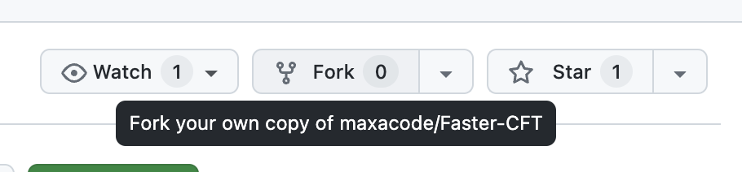
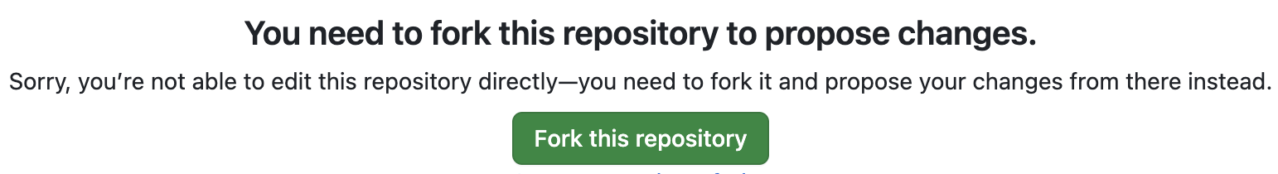
Adding code to Github
Go to Github Repository
Fork the Repository
Or edit a file then a Fork this repository will pop-up
Edit any file and Commit changes
Create pull request with comments

Slide 114
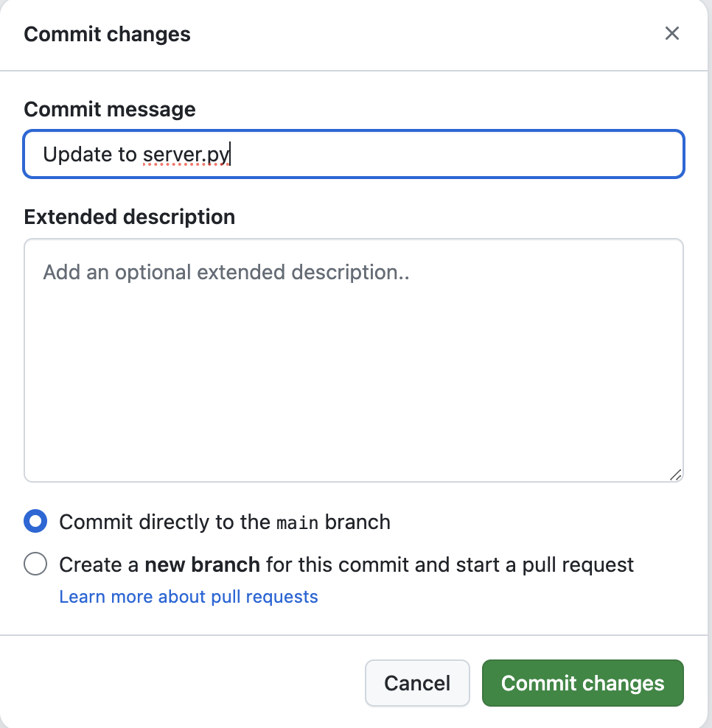
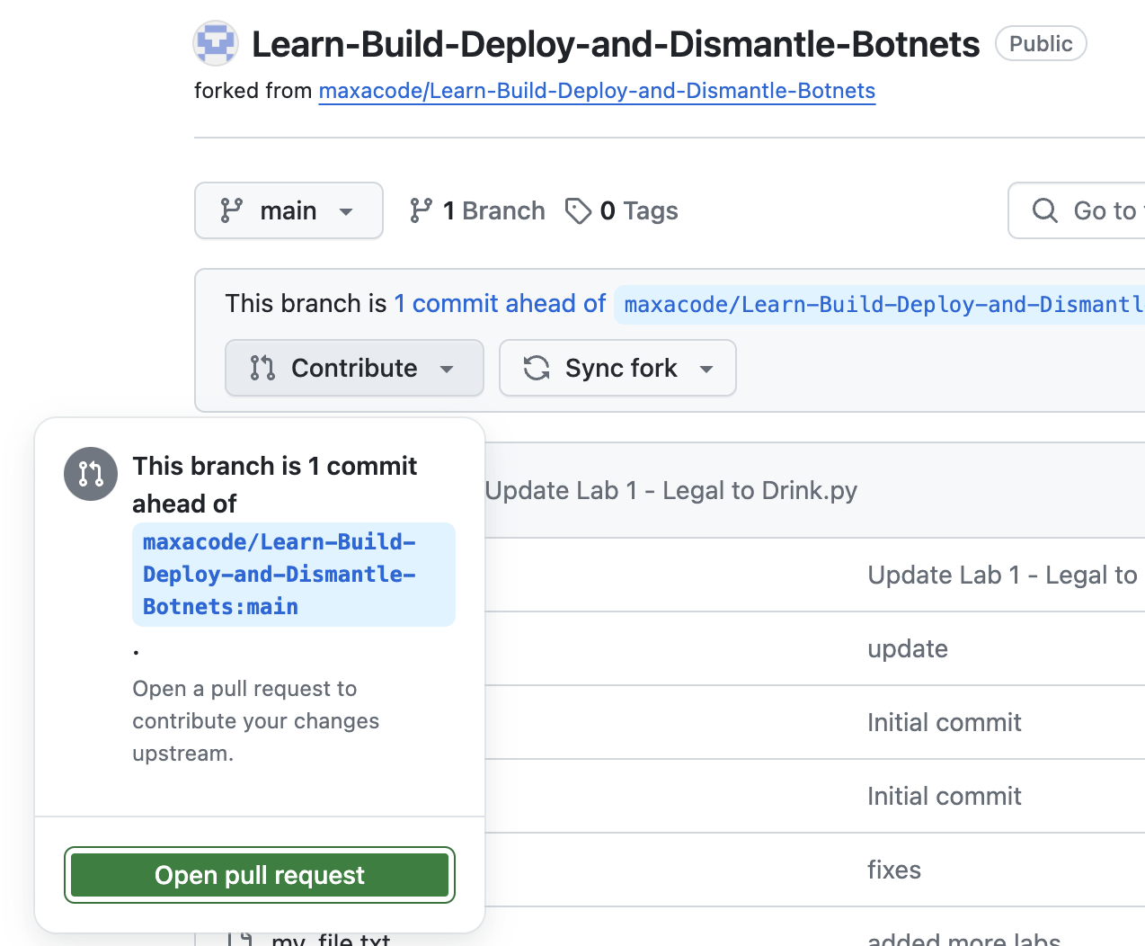
Adding code to Github

Slide 115
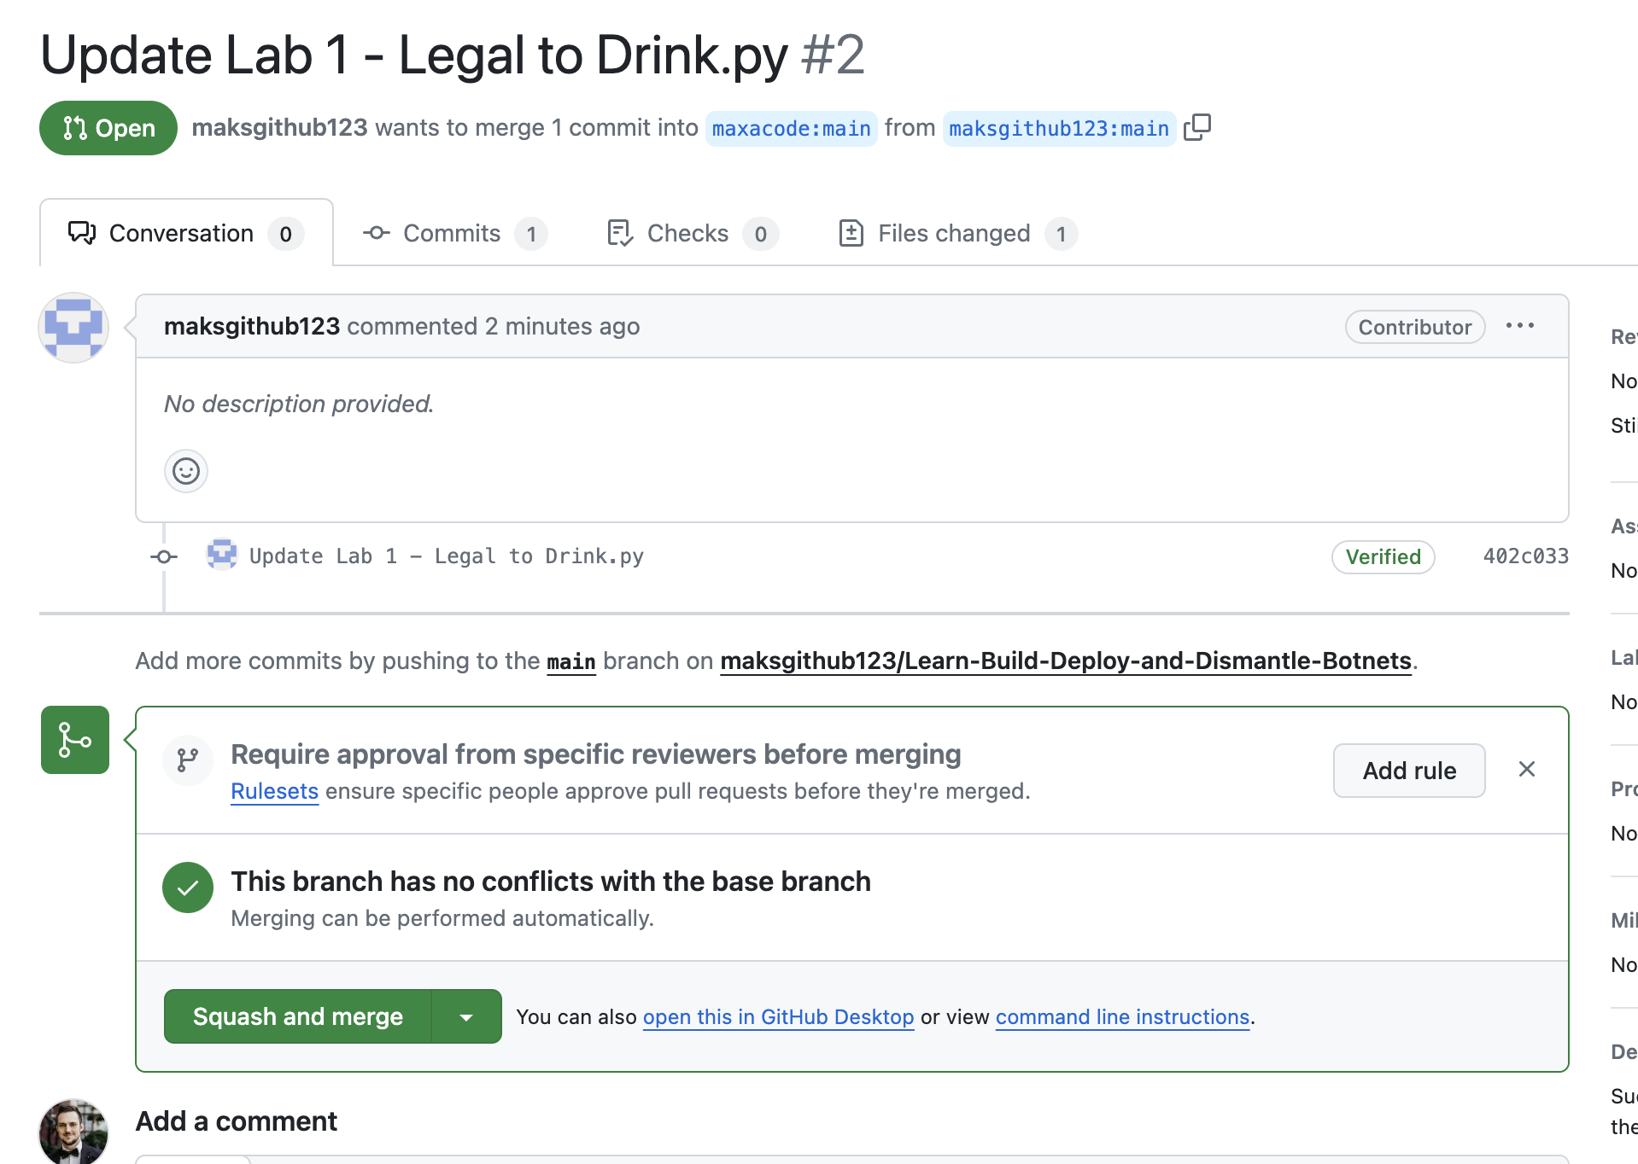
Adding code to Github

Slide 116
Thank You
Questions?

